Slide 1
Digital Chemistry Guided Development of Novel Ligands for Selective Ethylene Tetramerization
31st Annual Saudi-Japan Symposium
Dec 2022
Sibo Lin¹, Mohamed Elanany², Motaz Khawaji², Wei Xu², E. A. Jasser³, Samir Barman³ and Nestor Garcia³
¹Aramco Services Company: Aramco Research Center – Boston, Catalysis Technology Group, Cambridge, MA, USA
² Saudi Aramco: Aramco Research Center – KAUST, Fuels and Chemicals R&D Division, Thuwal, Saudi Arabia
³ Center for Refining and Advanced Chemicals, King Fahd University of Petroleum and Minerals, Dhahran 31261, Saudi Arabia

Slide 2
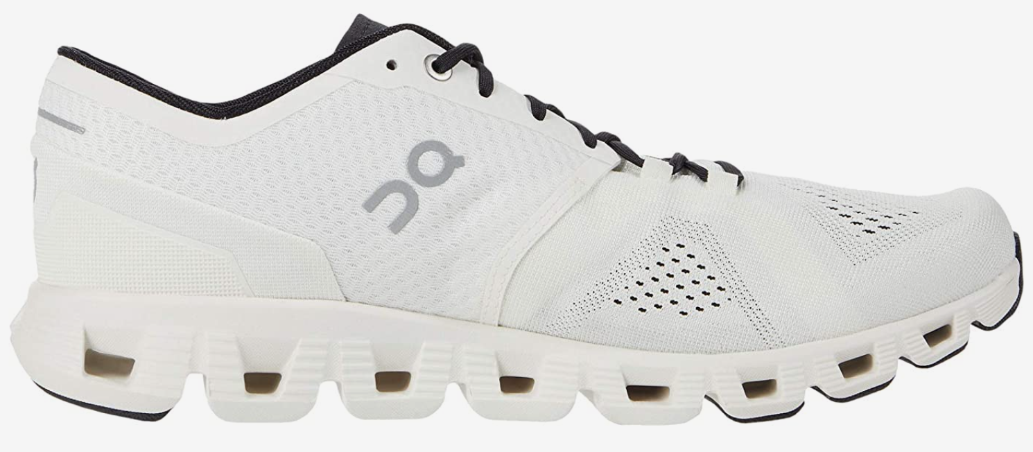
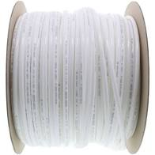

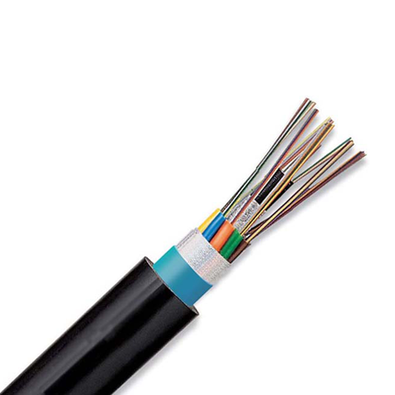
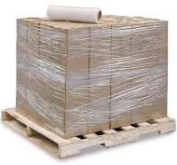
linear α-olefins for LLDPE
tough
flexible and food-safe
polyethylene plant
LLDPE
1-butene
ethylene
stretchable
electrical and chemical safety
1-butene
1-hexene
1-hexene
1-octene
polymer quality increases
highest quality plastic
1-octene

Slide 3
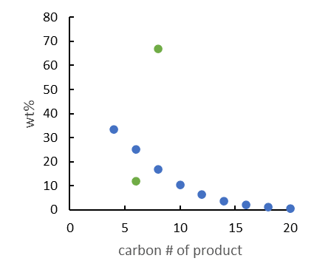

linear α-olefins for LLDPE
1-octene production
tough
flexible and food-safe
>65 wt% 1-octene
…but reactor fouling
1-butene
stretchable
electrical and chemical safety
1-hexene
undesired products
1-octene
<20 wt% 1-octene

Slide 4
Ethylene Tetramerization Challenges
reactor unit fouling
Bollman et al, J. Am. Chem. Soc. 2004, 126, 14712.
Strategy
Molecular design of novel catalysts that:
Increase activity
Increase 1-octene selectivity
Decrease PE wt%
Notes:
Benchmark References)
Bollman et al, J. Am. Chem. Soc. 2004, 126, 14712 (in toluene and CyH)
Blann et al, J. Catal. 2007, 249, 244. (in MeCy)

Slide 5
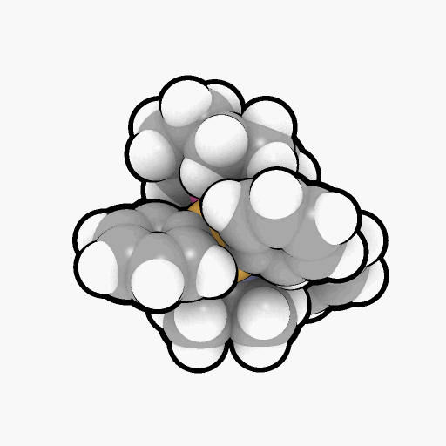
Accelerating Catalyst Discovery with Digital Chemistry
computer-guided workflow
traditional workflow
novel catalyst systems
supported catalyst systems
4 patents filed, 1 granted
ligand stability
reaction mechanisms
steric models
Notes:
Use graphics to describe challenges: increase activity, increase 1-octene selectivity, decrease PE selectivity

Slide 6
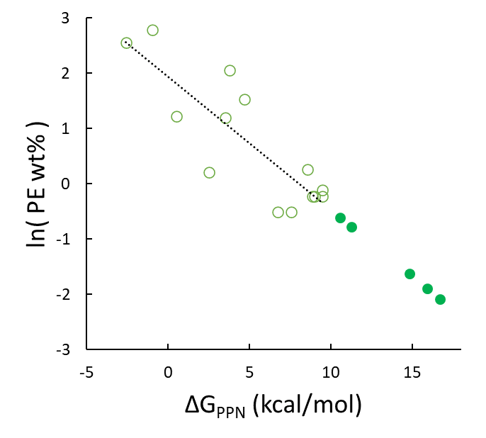
Ligand Stability Correlates with Lower PE wt%
Will extra-stable ligands yield very low polyethylene?
projected
activities
Lin, S.; Fromer, J. C.; Ghosh, Y.; Hanna, B.; Elanany, M.; Xu, W. Sci. Rep. 2021, 11, 4534.

Slide 7
Mechanism: Prior DFT Study
Observations
Simpler ligand used (N-Me instead of N-iPr)
Only explored a few conformers:
7 for ethylene adduct (18b)
3 for ethylene insertion TS (TS18f-19)
1 for beta hydride trainsfer TS (TS8-12)
Predicted too high 1-C₈/1-C₆ ratio (ΔΔG = 5.7 kcal/mol)
Empirically, 1-C₈/1-C₆ does not exceed ~6, even at high pressures—why?
Strategy
Analyze the full ligand (N-iPr)
More exhaustively search molecular conformations
Britovsek, G. J. P.; McGuinness, D. S. Chem. Eur. J. 2016, 22, 16891

Slide 8
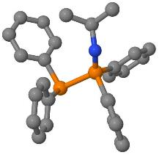
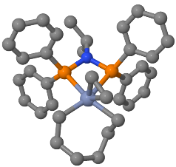
Mechanism: Automated Conformer Analysis
autoConf
Automated multi-level conformational search
Built on 3 open-source engines:
GFN-xTB/CREST
NWChem
GoodVibes
Simplified user input
Lightweight (for facile installation on internet-restricted compute clusters)
input geometry
(and charge and spin)
final structure and energy
XTBDFT
single-ended reaction coordinate scan
(GFN-xTB)
conformer ensemble generation & ranking
(CREST and GFN-xTB)
ensemble refinement (NWChem)
minimum final optimization (NWChem)
quasi-harmonic frequency corrections
(Goodvibes)
input reactant geometry
specify reaction coordinate
(and charge and spin)
final TS structure and energy
How many conformers within 6 kcal/mol window?
autoTS
Lin, S.; Fromer, J. C.; Ghosh, Y.; Hanna, B.; Elanany, M.; Xu, W. Sci. Rep. 2021, 11, 4534
Lin, S.; Elanany, M.; Khawaji, M. SoftwareX 2022, 20, 101242
Code and Tutorials at: https://github.com/sibo/xtbdft

Slide 9
XTBDFT Case Study: Ethylene Insertion Transition State
nohup xtbdft.py start.xyz -chrg 1 -uhf 3 -mode autoTS 28 65 1.6 -other=”-cbonds 1.0” &
“nohup” and “&” to run job in background
“-chrg” and “–uhf” to denote charge and unpaired electrons
“-mode” set to autoTS
Reaction coordinate:
Distance between atoms 28 & 65, from 3.06 to 1.60 Å
constrains all bonds with harmonic potential to prevent Cr-P dissociation
(1.0 Hartree/Bohr² force constant)
Lin, S.; Fromer, J. C.; Ghosh, Y.; Hanna, B.; Elanany, M.; Xu, W. Sci. Rep. 2021, 11, 4534
Lin, S.; Elanany, M.; Khawaji, M. SoftwareX 2022, 20, 101242
Code and Tutorials at: https://github.com/sibo/xtbdft

Slide 10
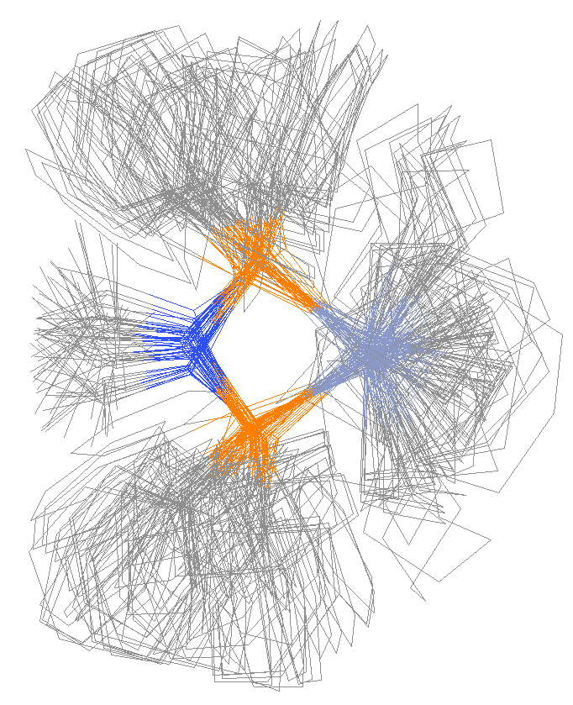
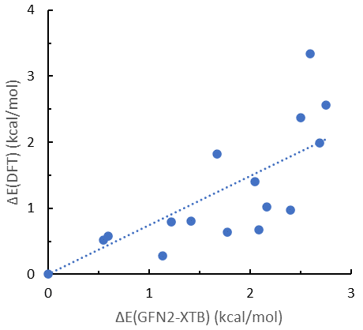
XTBDFT Case Study: Ethylene Insertion Transition State
a
b
c
reaction coordinate scan
GFN2-XTB can help screen the lowest energy conformers
reaction path finder
constrained conformer search
69 conformers within 6 kcal/mol window
Lowest energy conformer found by XTBDFT is 1.1 kcal/mol lower than that found by McGuinness
Lin, S.; Fromer, J. C.; Ghosh, Y.; Hanna, B.; Elanany, M.; Xu, W. Sci. Rep. 2021, 11, 4534
Lin, S.; Elanany, M.; Khawaji, M. SoftwareX 2022, 20, 101242
Code and Tutorials at: https://github.com/sibo/xtbdft

Slide 11
Mechanism: Rate-Limiting Steps
toward
1-hexene product
toward
C₁₀₊ products
toward
1-octene product
turnover-limiting barriers
Computational details: NWChem 6.8, M06-D3/def2-TZVP//B3LYP-D3/def2-SVP + solvation energy (M06-D3/def2-SVP)

Slide 12
Mechanism: 1-C₈ vs 1-C₆ Determining Steps
toward
1-hexene product
toward
C₁₀₊ products
ethylene ligand assists BHT
toward
1-octene product
T
Ethylene-assisted BHT explains why increased ethylene pressure does not yield higher 1-C₈/1-C₆
turnover-limiting barriers
product-determining barrier
ΔΔG(1-hexene/1-octene) = 3.1 – 0.6 = 2.5
Computational details: NWChem 6.8, M06-D3/def2-TZVP//B3LYP-D3/def2-SVP + solvation energy (M06-D3/def2-SVP)

Slide 13
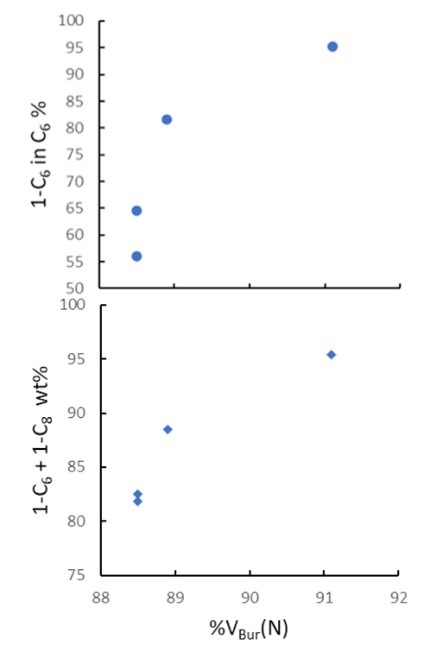
Ligand Bulk Correlates with Total LAO (1-C₆ + 1-C₈) wt%
Buried Volume @ Nitrogen: %V_{Bur}(N)
Calculated with SambVca
(Prof. Cavallo, KAUST)
Calculable for all PNP ligands
%V_{Bur}(N)
A
88.9
D
A
B
88.5
B
C
C
88.5
D
A
C
B
D
91.1
Barman, S.; Jaseer, E. A.; Garcia, N.; Elanany, M.; Khawaji, M.; Xu, W.; Lin, S.; Alasiri, H.; Akhtar, M. N.; Theravalappil, R. Chem. Commun. 2022, 58, 10044
Patent US11484871B1, Nov. 1, 2022.

Slide 14
Summary of Digital Chemistry for Ethylene Tetramerization
Ligand stability correlates with PE wt%
Reaction mechanism shows why 1-C₈/1-C₆ does not increase indefinitely with ethylene pressure
Buried volume steric models correlate with Total LAO wt%
vs.
c.f.

Slide 15
Acknowledgements
Aramco Americas
Advanced Materials Team (Cambridge, MA)
Saudi Aramco Chemicals R&D at KAUST
Mohamed Elanany
Motaz Khawaji
Wei Xu
Jenna C. Fromer
Yagnaseni Ghosh
Brian Hanna
Douglas Theberge
Dana A. Wong
Atieh Abu Raqabah
King Fahd Univ. of Petroleum and Minerals
E. A. Jaseer
Samir Barman
Nestor Garcia

Slide 17
Computational: Calculating PNP stability against PPN isomerization
2
2
3
2
3
2
3
how many conformers?
ca. 3³ x 2⁴ = 432
too many to rely on human intuition or employ brute-force high-level simulations
wrong ΔG
right ΔG

Slide 18
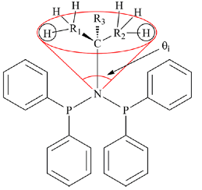
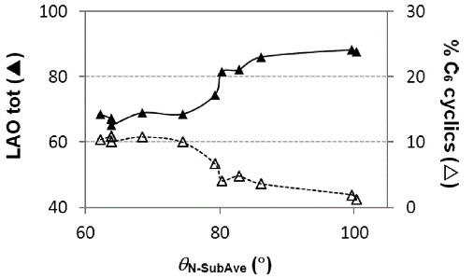
“Buried Volume” to Evaluate Ligand Sterics
Effective Tolman-based Cone Angle: θ_{N-Sub}
Sasol found correlation with LAO total (1-C₆ + 1-C₈)
Only useful for narrow range of PNP ligands
Buried Volume Around Nitrogen: %V_{Bur}(N)
Calculated with SambVca (Prof. Cavallo, KAUST)
Calculable for all PNP ligands
Correlates with some catalyst outputs
Cloete and coworkers, Inorg. Chem. 2013, 52, 2268-2270
%V_{Bur}(N) = 88.9

Slide 19

“Buried Volume” to Evaluate Ligand Sterics
Buried Volume Around Nitrogen: %V_{Bur}(N)
Calculated with SambVca (Prof. Cavallo, KAUST)
Calculable for all PNP ligands
Correlates with some catalyst outputs
%V_{Bur}(N) = 88.9
Buried Volume → higher productivity and lower PE wt%
Notes:
Geometries optimized by Mohamed with DMol3 as cationic, quartet spin chromacycloheptane species
Buried volumes calculated by Sibo with SambVca
Experimental data from 2 Sasol papers:
Kuhlmann et al, J. Catal. 2007, 245, 279-284
Blann et al, Chem Commun 2005, 620-621
These trends are much weaker with KFUPM’s experimental data in PhCl, other mechanisms/trends may be operative in different solvents.

Slide 20
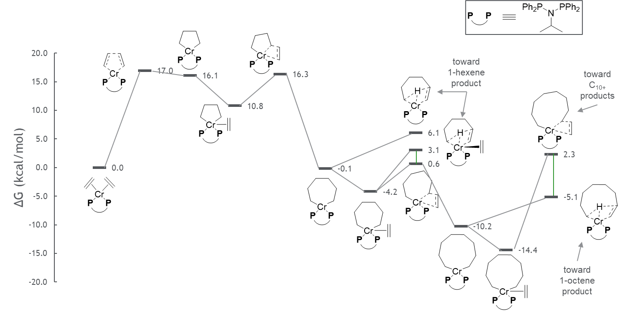
Computational: First Detailed Reaction Mechanism of Full Sasol Ligand
correct prediction of 1-octene/1-hexene ratio
turnover-limiting barriers
product-determining barriers
Ongoing: PhX solvents may act as secondary ligands to alter product distribution
Lin, S.; Elanany, M.; Khawaji, M.; Xu, W. ACS Catal. 2021, in preparation

